Slide 1
PROCEDURES IN ASSEMBLY
Group Members:
Mujtaba Bashir
Odiero Rosanne
Kiragu Ian
Munyui Julie
Wanjiku Kimani

Slide 2
Overview
Define a procedure
Advantages and Disadvantages of using procedures
Steps to make use of a procedure

Slide 3
Introduction
A procedure is the ASM equivalent of a Java or C++ function.
It is a subroutine, consisting of several lines of code, stored in memory that performs a specific task based on the parameters that it has been provided with.
To avoid writing the sequence of instructions again and again in the program, the same sequence can be written as a separate sub program called a procedure.
Each procedure should have a single purpose and be able to do its job independent of the rest of the program.

Slide 4
Advantages of using procedures
Program becomes easier to understand and more structured.
They help you gain major insight into how the runtime stack is used.
Reduced development time as each module can be implemented by different persons
Debugging of the smaller programs and procedures are easy
Reuse of procedures is possible

Slide 5
Disadvantage of using procedures
Extra code may be required to integrate procedures
Linking of the procedures may be required
Processor needs to do extra work to save status of the current procedure and load status of called procedure. The queue must be emptied so that instructions of the procedure can be filled in the queue.

Slide 6
six steps to make use of a procedure
Store the parameters (that need to be passed on to the procedure) where the procedure can access and retrieve them easily and quickly
Transfer control to the procedure
Have the procedure acquire the storage resources it requires
Have the procedure execute its specic task
Store the results (that need to be passed back to the calling program) where the calling program can access and retrieve them easily and quickly
Return control to the calling program, at the instruction that follows after the procedure call

Slide 7
Step 1 and 5
we need storage space that is easy and quick to access.
Therefore, we’ll put the parameters and results of a procedure in registers, specically dedicated for that.
There are 4 argument registers to store parameters and 2 value registers to store results:
argument registers
$a0, $a1, $a2, $a3
value registers
$v0, $v1

Slide 8
Step 2 and 6
To accomplish steps 2 and 6, we need a register that is dedicated to holding the memory address of the instruction that is currently being executed (remember that every program is stored in memory). We call this the program counter register. ($PC)
To remember which instruction (in the program that calls the procedure) to return to and continue with, after the procedure completes its task, we dedicate one register to store the address of the instruction following the instruction that calls the procedure: the return address register($RA). Indeed, the procedure could be called from many different places in our program.

Slide 9
Example
Assume that the current value of $PC is I-4. After executing the instruction at memory address I-4, $PC is incremented with 4, to I, to execute the next instruction. Assume that the instruction at memory address I tells the CPU to jump to procedure A which starts at the address J and finishes at J+8. Let's take a look at how the value of $PC and $RA should change throughout this process.

Slide 10
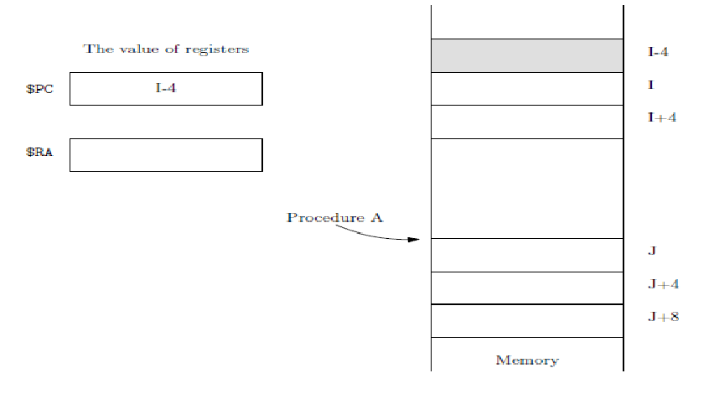
Executing the instruction at I-4.

Slide 11
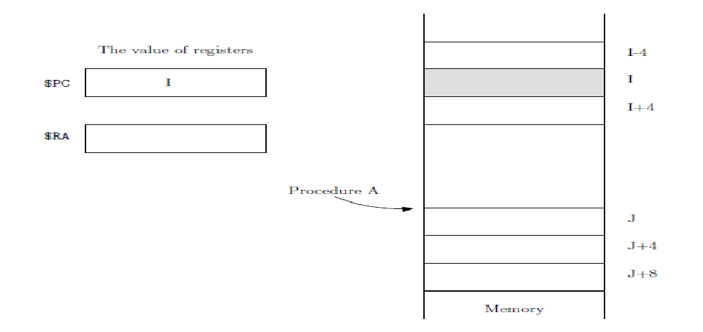
The instruction at I wants the CPU to jump to procedure A, and execute procedure A. However, before jumping away, the address of the next instruction, to be executed upon return from A, i.e., I+4, gets stored in $RA.

Slide 12
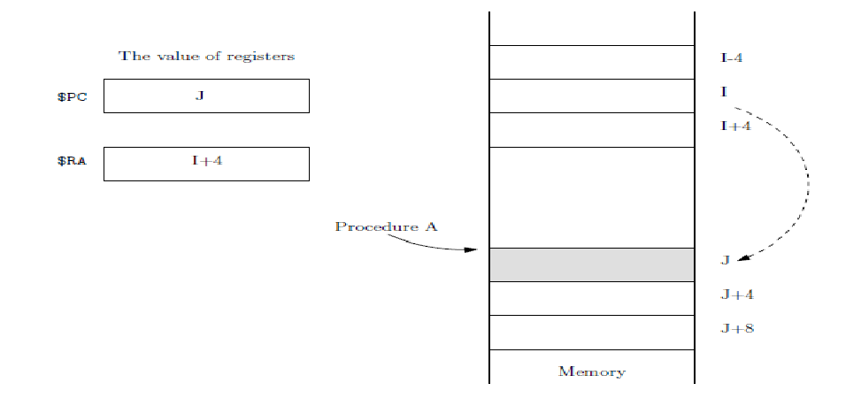
After storing the value I+4 in $RA, the CPU “jumps” to procedure A by loading the address J into $PC.

Slide 13
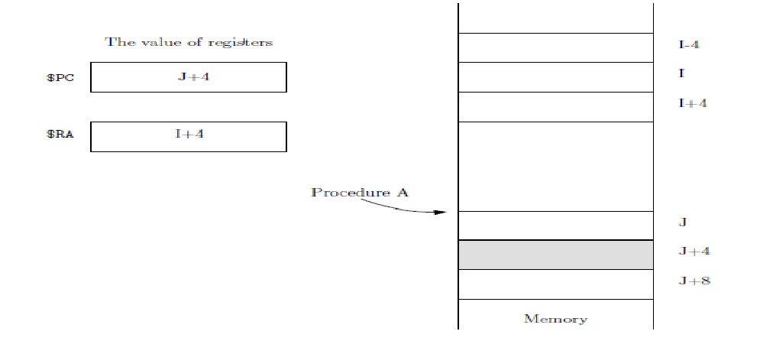
Executing the task specific to procedure A, which, in this case, consists of only 1 instruction.

Slide 14
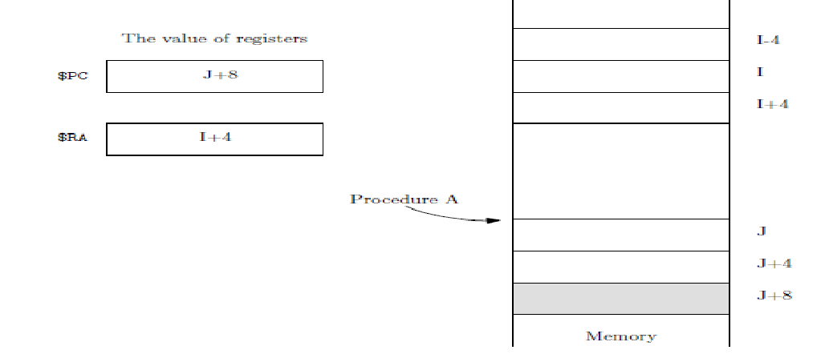
The last instruction of procedure A needs to ensure program execution returns to where the procedure was called from. This can be achieved by loading the return address stored in $RA into $PC.

Slide 15
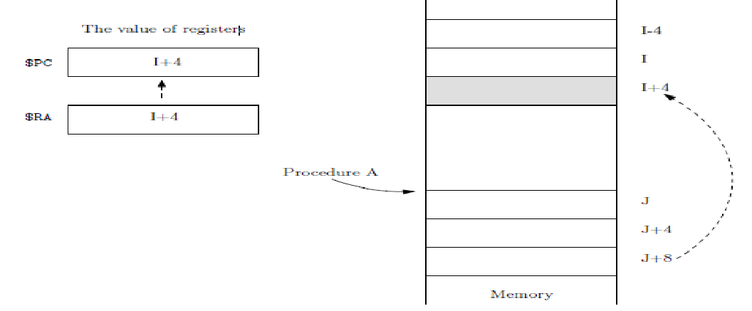
Return to where A was called from and execute the next instruction, after loading the return address stored in $RA into $PC.

Slide 16
Summarily:
To call a procedure at memory address J, we need to:
RA = PC + 4
PC = J
This can be achieved using a jump-and-link instruction, jal J (“jumping” to J, after “linking”, i.e., saving the return address).
To return from the procedure, we need to:
PC = RA
This can be achieved by jr $RA.

Slide 17
Procedure syntax
Following is an assembly language procedure named sample:
Sample PROC
.
.
ret
Sample ENDP

Slide 18
A procedure is called from another function by using the CALL instruction.
The CALL instruction should have the name of the called procedure as an argument
CALL proc_name
The called procedure returns the control to the calling procedure by using the RET instruction.

Slide 19
Example code for a procedure
section .text
global _start
_start:
mov ecx,'1'
sub ecx, '0'
mov edx, '1'
sub edx, '0'

Slide 20
call sum
mov [res], eax
mov ecx, msg
mov edx, len
mov ebx,1 ;file descriptor (stdout)
mov eax,4 ;system call number (sys_write)
Int 0x80
mov ecx, res
mov edx, 1
mov ebx, 1 ;file descriptor (stdout)
mov eax, 4 ;system call number (sys_write)
int 0x80

Slide 21
mov eax,1 ;system call number (sys_exit)
int 0x80 ;call kernel
sum:
mov eax, ecx
add eax, edx
add eax, '0'
ret
section .data
msg db "The sum is:", 0xA,0xD
len equ $- msg
segment .bss
res resb 1

Slide 22
Additionally, procedures can automatically:
- Preserve register values that should not change but that the procedure might otherwise alter.
- Set up a local stack pointer, so that you can access parameters and local variables placed on the stack.
- Adjust the stack when the procedure ends.
The parts of the procedure directive include:
- label - the name of the procedure.
- attributes - call distance, calling convention, and visibility of the procedure.
- parameter - the list of input parameters to be passed to the procedure on the stack.

Slide 23
- reglist - a list of registers (separated by spaces) following the USES keyword
- The registers will be saved on the stack upon procedure entry.
- Registers in the list must be separated by blanks or tabs, not by commas.
- The assembler generates prologue code to push registers onto the stack upon entry.
- Upon exit assembler generates epilogue code to pop the saved registers off the stack.

Slide 24
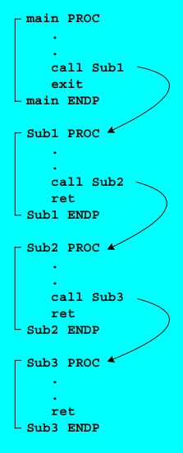
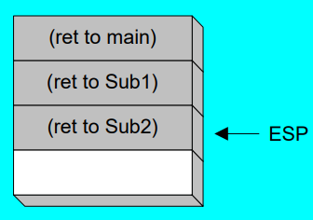
Nested Procedure Calls
By the time Sub3 is called, the stack contains all three return addresses:

Slide 25
Passing Arguments on the Stack
Data, passed to a procedure, are called input arguments. Most common method is the stack.
Calling conventions describe:
- The order in which parameters are allocated.
- Where parameters are placed (pushed on the stack or placed in registers.)
- Which registers may be used by the procedure.
- Whether the caller or the callee is responsible for unwinding the stack upon return.

Slide 26
The Stack
Stack is a LIFO linear data structure which is memory region within the program.
This part of the memory gets allocated when a process is created.
We use Stack for storing temporary data such as local variables of some function, environment variables which helps us to transition between the functions, etc
The stack segment register holds the starting address of the stack segment in memory.
Operations carried out in a Stack
- push - adds an element to the collection
- pop - removes the most recently added element on top of the Stack
- peek/top - returns top element of stack

Slide 27
Register components are saved in the stack temporarily during execution to be used for other purposes.
Elements are accessed using the pointer that is implemented using the SP and SS registers.
Storing the data words onto the stack, decrements the pointer.
Majorly SS is used for the following purposes:
To hold the temporary results.
To hold the return address of the subroutine.
Finally to handle the interrupts
• SS Register: holds stack Segment Address
• SP Register: initialized to the value specified with the stack directive, represents empty stack position When stack is not empty, SP represents the top of the stack.

Slide 28
PUSH And PUSHF
PUSH: Used to add a new source (16-bit register or memory word) on stack
Syntax: PUSH source
Execution of PUSH causes: SP is decreased by 2
A copy of source contents is moved to the address specified by SS:SP.
Source remains unchanged
PUSHF has no operand and it pushes the contents of FLAG register onto the stack.
Usually this is done whenever the processor is interrupted
Syntax: PUSHF

Slide 29
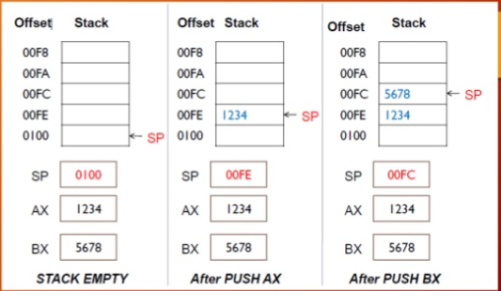

Slide 30
POP And POPF
POP: Used to remove top item from stack to destination (i.e. a 16-bit register or memory word).
Syntax: POP destination
Execution of POP causes: The contents of SS:SP (top of the stack) is moved to the destination. SP is increased by 2
POPF has no operand and pops the top of the stack into FLAG register.
SP is incremented by 2 after executing this instant.
Syntax: POPF

Slide 31
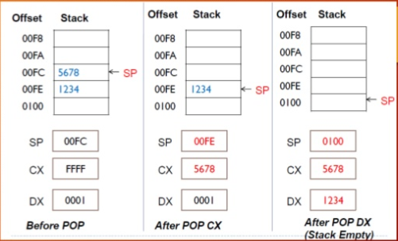

Slide 32
Applications of stack:
- Balancing of symbols
- Infix to Postfix /Prefix conversion
- Redo-undo features at many places like editors, photoshop.
- Forward and backward feature in web browsers
- Used in many algorithms like Tower of Hanoi, tree traversals, stock span problem, histogram problem.
- Other applications can be Backtracking, Knight tour problem, rat in a maze, N queen problem
- Implement functions
- Processing nested structures
- implement functions, parsers, expression evaluation, and backtracking algorithms.

Slide 33
There are three ways to implement stacks:
Using arrays
Using linked lists
Using vectors
Implementation Strategy
- Allocate a contiguous region of memory as the total available stack space;
- Pack stacked data -- the allocated portion of the reserved stack space -- at one end of the region, leaving the rest available to be allocated;
- Use a single register (called the stack pointer or SP within the CPU to identify the boundary between allocated and available stack space;
- Allocate and deallocate space simply by incrementing and decrementing the stack pointer

Slide 34
We need to implement:
- Stack * initstack(void)
"creates" and initializes stack, S of type Stack and returns a pointer to S. If it is not possible to create a stack, it returns a pointer to NULL.
- int empty(Stack *S)
returns true if the stack, S, is empty and false otherwise.
- int full(Stack *S)
returns true if the stack, S, is full and false otherwise.
- int push(ItemType X, Stack *S)
pushes X on the stack, only if S is not full. Success or failure is indicated by the integer return value. A return value of 1 indicates success, a return value of 0 indicates failure.

Slide 35
- int pop(Stack *S, ItemType *X)
returns the item popped off the stack in X, only if S is not empty. A return value of 1 indicates success, a return value of 0 indicates failure.
- void stackprint(Stack *S, char *format)
prints the current contents of the stack from the top of the stack to the bottom using the format string that is passed in and which is appropriate for ItemType.
It should indicate which is the item at the top of the stack

Slide 36
Example code to implement a stack:
include 'win32ax.inc' ;used for proc macros only
MAXSIZE = 256
section '.text' code readable executable
start:
;test code
push 12345
call myPush
push 22222
call myPush
call myPop
call myPop
ret

Slide 37
proc myPush x
cmp [_top], MAXSIZE ;did we exceed stack size
ja stack_full
inc [_top] ;update the last element position
mov eax, [_top]
mov esi, _stack
mov edx, [x]
mov dword [esi+eax*4], edx ;write the value to stack
stack_full:
;do something when stack is full
ret
endp

Slide 38
proc myPop
cmp [_top], 0 ;did we write anything previously
jbe stack_empty
mov eax, [_top]
mov [_stack+eax*4], 0 ;clear stack value at last position
dec [_top] ;decrease last element position
stack_empty:
;do something when stack is empty
ret
endp

Slide 39
Implementing a stack using:
Arrays
DB 's', 'n', 'i', 't', 'c',’h’, 69
mov ax,'ch'
push ax
mov ax,'it'
push ax
mov ax,'sn'
push ax
What will be the pointer SP point to?

Slide 40
Ans:
SP points to 'snitch',69
#No pun intended

Slide 41
Linked Lists
extern malloc
extern free
extern putchar
extern puts
section .data
size_i: ; Used to determine the size of the structure

Slide 42
struc node
info: resd 1
next: resd 1
endstruc
len: equ $ - size_i ; Size of the data type

Slide 43
nullMes: db 'Null pointer - the list is empty', 0
addMes: db 'Adding a new element', 0
printMes: db 'Printing a linked list:', 0
cleanMes: db 'Cleaning an element', 0
doneCleanMes: db 'Ready for cleaning...', 0
emptyListMes: db '- empty list -', 0
section .bss
prim: resd 1

Slide 44
; Procedure: append
; Appends an element at the end of a linked list
; If the linked list is empty, initialize the list
; Params (in order of pushing on the stack):
; dword element - data to be added
; dword prim - first element in the list
; Return: none
; Modifies the value of prim if it is null
append:
push ebp ; Save the stack
mov ebp, esp

Slide 45
push eax ; Save the registers
push ebx
push len ; Size to get from the heap and pass the size to the malloc function
call malloc ; Call the malloc function - now eax has the address of the allocated memory
mov ebx, [ebp + 12]
mov [eax + info], ebx ; Add the element to the node data field
mov dword [eax + next], 0 ; Address of the next element is NULL, because it is the last element in the list
mov ebx, [ebp + 8] ; Retrieve the address to the first element
cmp dword [ebx], 0
je null_pointer

Slide 46
mov ebx, [ebx] ; This parameter was the address of the address
; Now it is the address of the first element, in this case, not null
; If it is not NULL, find the address of the last element
next_element:
cmp dword [ebx + next], 0
je found_last
mov ebx, [ebx + next]
jmp next_element
found_last:
push eax
push addMes
call puts
add esp, 4 ; Restore the stack
pop eax

Slide 47
mov [ebx + next], eax ; Last element is this one from the newly allocated memory block
go_out:
pop ebx ; Restore registers
pop eax
mov esp, ebp
pop ebp
ret 8 ; Return to the caller function and cleaning the stack

Slide 48
null_pointer:
push eax
push nullMes
call puts
add esp, 4
pop eax
mov [ebx], eax ; Point the address of the first element to the allocated memory
jmp go_out

Slide 49
Explanation:
Malloc, free, putchar and puts are library functions.
Structure for the list node and several strings for messages defined in the data section.
The .bss section is for uninitialized variables, in this case the pointer points to the NULL list head, because the list is empty at first.
The code retrieves one of the parameters from the stack – the data to add in the new node, then memory is allocated for the new node and its pointer placed in the EAX register.
The node structure is filled with the required data and pointer to next element – NULL – as it will be the last element.
Then a loop through all elements until the last one is reached, that will be linked to the newly created node through its “next” field. A message is printed when an element is added or otherwise..

Slide 50
; Procedure: pop
; Retrieves the first element in the list in eax and deletes it.
; The list acts like a queue
; Params:
; - address to the address of the first element
; Return: eax = the element removed
pop:
push ebp
mov ebp, esp
push ebx
push edx
push ecx

Slide 51
mov ebx, [ebp + 8] ; Address of the address of the first element
mov eax, [ebx] ; Address of the first element
cmp eax, 0
je donePop ; Don't do anything if the list is empty
mov edx, eax
mov eax, [eax + info] ; The information stored in the element
mov ecx, [edx + next]
mov [ebx], ecx ; The address to the first element changed to point to the next one

Slide 52
pusha ;
push edx ; Free the allocated resources
call free
add esp, 4
popa
donePop:
pop ecx
pop edx ; Done - restore the registers and return to the calling procedure
pop ebx
mov esp, ebp
pop ebp
ret 4
This one will store the data in the first element in EAX as a return value. Then the address to the first element is changed to its successor. Memory is thus freed.

Slide 53
; Procedure: cleanup
; Deallocate the memory used by a linked list
; This function is recursive
; Params:
; - address of the list node to free ([ebp + 8])
; Return: none
cleanup:
push ebp ; Save the stack pointer
mov ebp, esp
push eax ; Save the working registers

Slide 54
mov eax, [ebp + 8] ; Retrieve the parameters
cmp eax, 0 ; If the address is NULL, then it is past the end of the list
je doneCleaning ; No more recursive calls; print an appropriate message
push dword [eax + next] ; Push the address of the next element as parameter for the next call to this procedure
call cleanup
pusha ; Print a message that cleaning is underway
push cleanMes
call puts
add esp, 4
popa

Slide 55
push eax ; Push the address of the current element as parameter for the free function
call free
add esp, 4 ; Aaargh I hate these unpredictable stdlib procedures!
doneAll: ; Prepare to exit the procedure
pop eax
mov esp, ebp
pop ebp
ret 4
This is a recursive function. Memory is deallocated starting with the last element.

Slide 56
; Procedure: print
; Prints the elements of a linked list
; The elements are considered ASCII characters, otherwise things might blow in your face with various degrees of terribleness
; Params (in order of pushing on the stack):
; dword prim - address of the first element
; Return: none
print:
push ebp
mov ebp, esp

Slide 57
push ebx
mov ebx, [ebp + 8] ; Address of the first element
cmp ebx, 0
je emptyList
push eax
push printMes ; Print message "Printing a linked list"
call puts
add esp, 4
pop eax

Slide 58
next_char:
push dword [ebx + info]
call putchar
mov ebx, [ebx + next]
cmp ebx, 0
jne next_char
push dword 10
call putchar

Slide 59
done:
pop ebx
mov esp, ebp
pop ebp
ret 4
emptyList:
pusha
push emptyListMes
call puts
add esp, 4
popa
jmp done
Sequential iteration through the list to display each character

Slide 60
On to the main file:
section .text
global main
main:
push ebp ; Standard procedure entry
mov ebp, esp
mov dword [prim], 0 ; Pointer is NULL initially - the list is empty
push dword 'a' ; Element to add to the list
push prim ; Address of the first element in the list and pass it to the init function, through the stack
call append ; Call the init function

Slide 61
push dword 'b'
push prim
call append
push dword 'c'
push prim
call append
mov ecx, 1

Slide 62
push ecx
push dword 'Z'
push prim
call append
pop ecx
loop
push dword [prim] ; Send the list to printing to the stdout
call print
push prim ; Remove the first element: a
call pop

Slide 63
push dword [prim]
call print
push prim ; Remove the first element: b
call pop
push dword [prim]
call print
push prim ; Remove the first element: c
call pop
push dword [prim]
call print
push prim ; Remove the first element: Z
call pop
ret

Slide 64
push dword [prim]
call print
push prim ; Remove the first element: nil
call pop
push dword [prim]
call print
push dword [prim] ; Deallocate memory
call cleanup
mov esp, ebp ; Restore the stack
pop ebp

Slide 65
Procedure Linking
Working with an external library allows us to write programs that use procedures which we don’t know how to write.
An example is the Irvine32.lib library which helps in simplifying tasks related to input-output and string handling in assembly language.
Linking and Link Libraries
A link library is a file containing procedures that have already been assembled in machine language code.
These procedures can be linked to a procedure that is written separately.

Slide 66
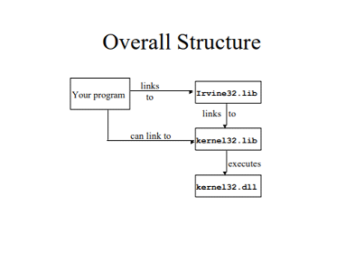

Slide 67
The above flowchart illustrates how linked libraries work
The Irvine32 link library contains a large collection of procedures that are useful in writing 32-bit assembly language programs.
Example of a procedure contained in the library:
DumpRegs : Displays the contents of the EAX, EBX, ECX, EDX, ESI, EDI, EBP, ESP, EIP and EFLAGS registers in hex format. i.e
Call DumpRegs

Slide 68
Include irvine32.inc
Section .data
X dword 2000h
Y dword 2100h
Z word 4500h
Msg byte “ Hello World”,0xa
Main proc
Push y
Push z

Slide 69
Mov eax, x
Push eax
Mov dx, offset msg
Mov eax
Pop z
Pop y
Main endp

Slide 70
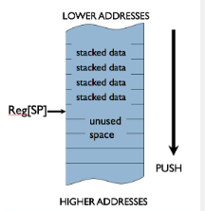
Stack Insight:
The efficacy of the stack implementation strategy is that any stack discipline assures that the next data to be allocated or deallocated will be located adjacent to the address in the stack pointer.
Consider the snapshot at the right, depicting a region of memory allocated to a stack. In this implementation, stacked data is packed into lower addresses, and higher-addressed locations are available to be allocated to new data.
The SP register contains the address of the lowest unallocated location, i.e. of the next location to be allocated to stacked data.

Slide 71
In its simplest form, a stack supports two abstract operations:
- push(datum): add the value datum to the stack; and
- datum = pop(): remove the most recently added datum from the stack, and return its value.
The push/pop interface assumes a stack of some fixed datum size, typically a 32-bit word. The most recently stacked datum is referred to as the top value on the stack;
it is the value that will be returned from a pop() operation. Immediately following the operation push(x), x becomes the top value on the stack. Thus the sequence push(x); pop() adds then removes x, leaving the stacked data unchanged.

Slide 72
In addition to the abstract interface provided by the push/pop operations, it is common to directly access data near the top of the stack. Such data is typically at an address that is a constant offset from the value in the SP.16.2.3.2. Processor Stack
As an abstract data structure, stacks have many applications. Often applications will create stacks for dedicated purposes -- examples include the undo/redo stack of an editor, and the history stack of a browser.
However, the rules of stack discipline make a single stack eminently sharable among various different uses that conform to the same proper nesting constraint.
As proper nesting is a property of most common program control flow patterns -- including entering/exiting blocks, procedure call/return, and interrupts -- modern processors and run-time software conventions commonly assume a single stack that is shared among these purposes.

Slide 73
The evolution of the processor stack assumption is complex and interesting.
Indeed, the design of modern block-structured languages and consequent programming disciplines reflect the availability of a stack to at least the extent that support for a stack is demanded by these languages and disciplines.
It has become popular for those committed to alternative programming structures -- involving, say, parallel processing and other control flow less amenable to stack discipline -- to complain about the extent to which stacks and consequent nesting are institutionalized by contemporary processor design.
But the efficiency with which a stack handles a wide range of contemporary programming needs assures its continued support in future ISA generations.

